Slide 1
Cloud Deployment Models
Here is where our presentation begins
17/02/2026
Daniele Buscemi Luca Tarallo
CSP 2025/2027

Slide 2
1
Definition
Daniele Buscemi Luca Tarallo
Your Company Name

Slide 3
Definition
Cloud Deployment Models
Where your cloud infrastructure lives, who manages it and who can access it.
There are four main models:
-Public cloud -Private cloud
-Hybrid cloud -Multi-cloud
It is like choosing from what kind of building your business operates.
Daniele Buscemi Luca Tarallo

Slide 4
2
Why It Exists
You can enter a subtitle here if you need it
Daniele Buscemi Luca Tarallo
Your Company Name

Slide 5
Let’s have a look
Before cloud computing, every company had to buy, maintain, and secure its own physical server ---- expensive, slow to scale, and a nightmare to manage. When cloud computing emerged, organizations faced a new question: how do we deploy our infrastructure in a way that balances cost, control, security, and flexibility?
Not every business has the same needs. A hospital handling patient records has very different requirements than a music streaming startup. Deployment models exist to give organizations a structured way to answer the question: "What's the right cloud setup for us?"
Daniele Buscemi Luca Tarallo

Slide 6
3
How It Works
Daniele Buscemi Luca Tarallo
Your Company Name

Slide 7
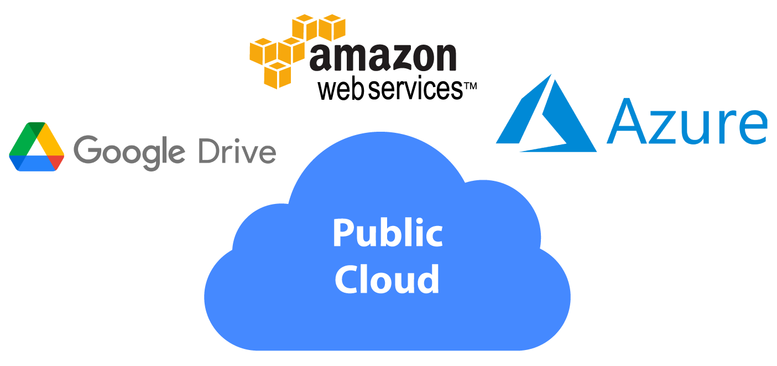
Public cloud
Step 1
A provider like AWS, Google Cloud, or Microsoft Azure builds and owns massive data centers around the world.
Step 2
Businesses rent computing resources (servers, storage, databases) from that provider over the internet.
Step 3
Multiple customers share the same underlying physical infrastructure, but their data is logically separated and isolated.
Step 4
You pay for what you use.
No hardware to buy, no data center to run.
Daniele Buscemi Luca Tarallo

Slide 8
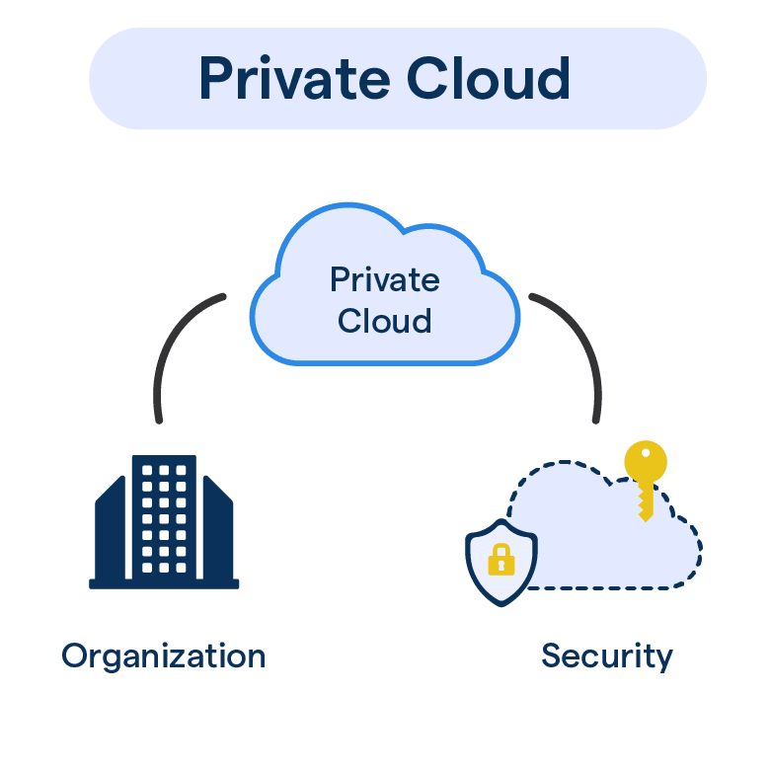
Private cloud
Step 1
Infrastructure is dedicated exclusively to one orgranization.
Step 2
It can be hosted on-premises (in the company's own data center) or by a third-party provider, but it's never shared with others
Step 3
The organization has full control over security, configuration, and compliance
Step 4
It behaves like a cloud (self-service, scalable) but within a walled environment
Daniele Buscemi Luca Tarallo

Slide 9
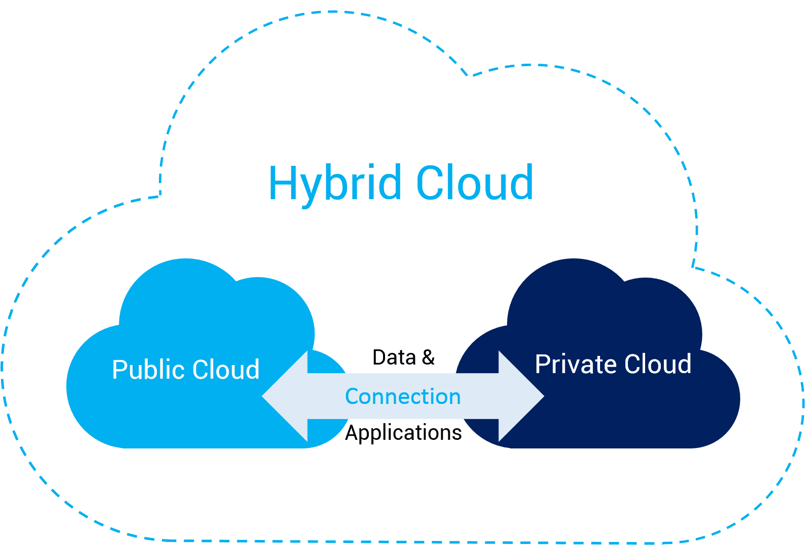
Hybrid cloud
Step 1
A company runs some workloads on a private cloud (or on-premises servers) and others on a public cloud.
Step 2
The two enviroments are connected via secure networks or APIs, allowing data and applications to move between them
Step 3
Sensitive data stays in the private environment; scalable or less sensitive workload run in the public cloud
Step 4
Orchestration tool manage wich workload runs where, often automatically.
Daniele Buscemi Luca Tarallo

Slide 10
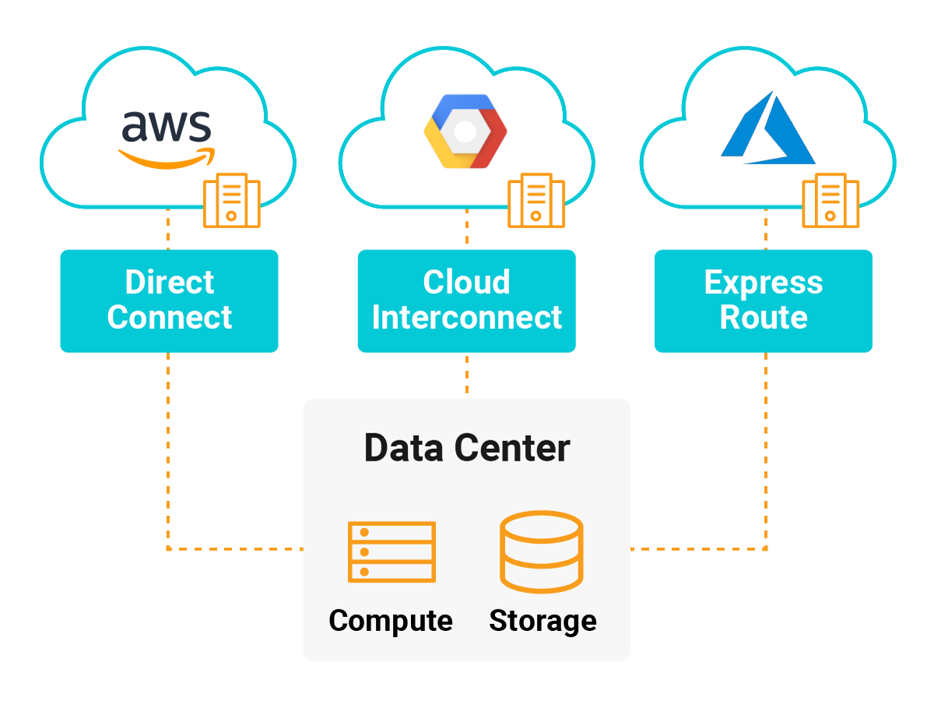
Multi-cloud
Step 1
A company uses services from multiple public cloud providers simultaneously (AWS + Azure + Google Cloud)
Step 2
Different providers are chosen for different strenghts: maybe AWS for compute, Google Cloud for AI/ML, Azure for Microsoft integrations.
Step 3
Management platforms sit on top to unify monitoring, billing, and security across all providers.
Daniele Buscemi Luca Tarallo

Slide 11
4
Real World Examples
Daniele Buscemi Luca Tarallo

Slide 12

Real-World Examples
Netflix
Major Bank
Public Cloud (AWS)
Hybrid Cloud
Government Agency
Spotify
Private Cloud
Multi-Cloud
Daniele Buscemi Luca Tarallo

Slide 13
5
Advantages & Benefits
Daniele Buscemi Luca Tarallo

Slide 14
Advantages & Benefits
Public
Cloud
Private
Cloud
Hybrid
Cloud
Shines on cost (no upfront investment), speed of deployment, infinite scalability
Easy to control, guarantee security and compliance.
Offers the best of both worlds
Multi
Cloud
Reduces vendore dependency, maximizes resilience.
Daniele Buscemi Luca Tarallo
Your Company Name

Slide 15
6
Risks & Challenges
Daniele Buscemi Luca Tarallo

Slide 16
Risks & Challenges
Public
Cloud
Private
Cloud
Hybrid
Cloud
Comes with less control over where data physically lives, potential compliance headaches in regulated industries, and the risk of unexpected costs if consumption isn't monitored carefully (cloud bills can spiral fast)
Is expensive. You're essentially buying and managing your own hardware. It requires a skilled internal IT team, and scaling is limited by physical capacity. It also lacks tha global reach that public cloud providers offer out the box.
Introduces significant complexity. Connectiong two enviroments securely, keeping data synchronized, and managing policies across both requires sophisticated tooling and expertise. Integration failures can create security gaps.
Multi
Cloud
Is arguably the most complex of all. Managing billing, security, identity, and compliance across three or four different providers, each with their own tools, APIs, and pricing models. Demands serious orchestration overhead. It can also make it harder ti iprimize costs, since workloads are scattered across platforms.
Daniele Buscemi Luca Tarallo
Your Company Name

Slide 17
Thanks!
Do you have any questions?
Please keep this slide for attribution
Daniele Buscemi Luca Tarallo
Your Company Name

